Slide 1

Explore Zomato restaurants Dataset in the city of New Delhi

Slide 2
Introduction
New Delhi is the capital city of India. It is a part of the city of Delhi’s 11 districts. The city itself has a population of 257,803. However, the much larger metro area has a population that exceeds 26 million.
With its diverse culture , comes diverse food items. There are many restaurants in New Delhi City, each belonging to different categories like Chinese , Italian , French etc.
So as part of this project , we will list and visualize all major parts of New Delhi City

Slide 3
Objectives
Questions that can be asked using the above mentioned datasets
What is best location in New Delhi City for Chinese Cuisine ?
Which areas have large number of Chinese Restaurant Market ?
Which all areas have less number of restaurant ?
Which is the best place to stay if I prefer Chinese Cuisine ?
What places are have best restaurant in New Delhi?

Slide 4
Data
For this project we need the following data :
New Delhi Restaurants data that contains list Locality, Restaurant name,Rating along with their latitude and longitude.
Data source : Zomato kaggel dataset
Description : This data set contains the required information. And we will use this data set to explore various locality of new delhi city.
Nearby places in each locality of new delhi city.
Data source : Fousquare API
Description : By using this api we will get all the venues in each neighborhood.

Slide 5
Approach
Collect the new delhi city data from Zomato kaggel dataset
Using FourSquare API we will find all venues for each neighborhood.
Filter out all venues that are nearby by locality.
Using aggregative rating for each resturant to find the best places.
Visualize the Ranking of neighborhoods using folium library(python)

Slide 6
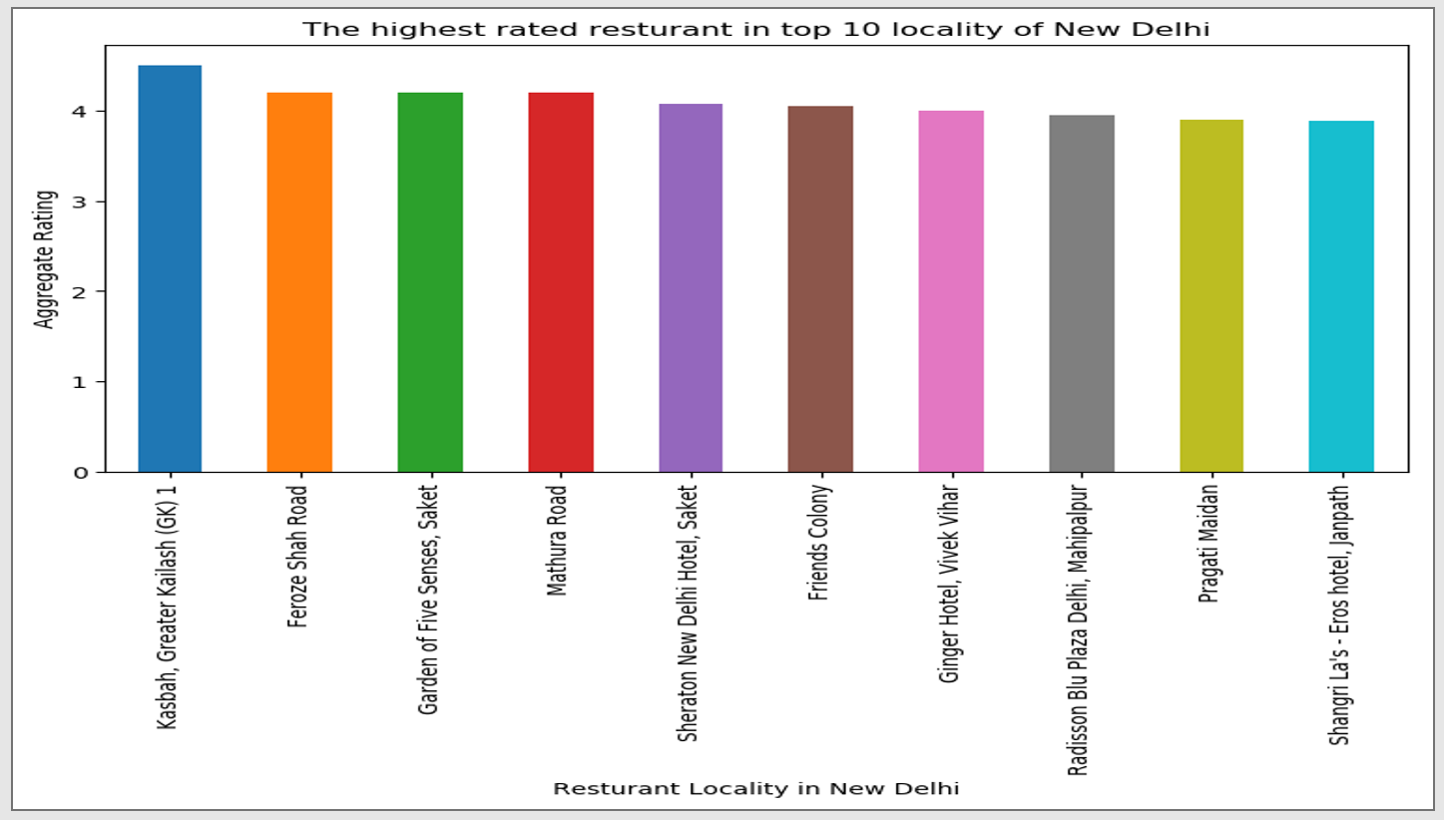
Results

Slide 7
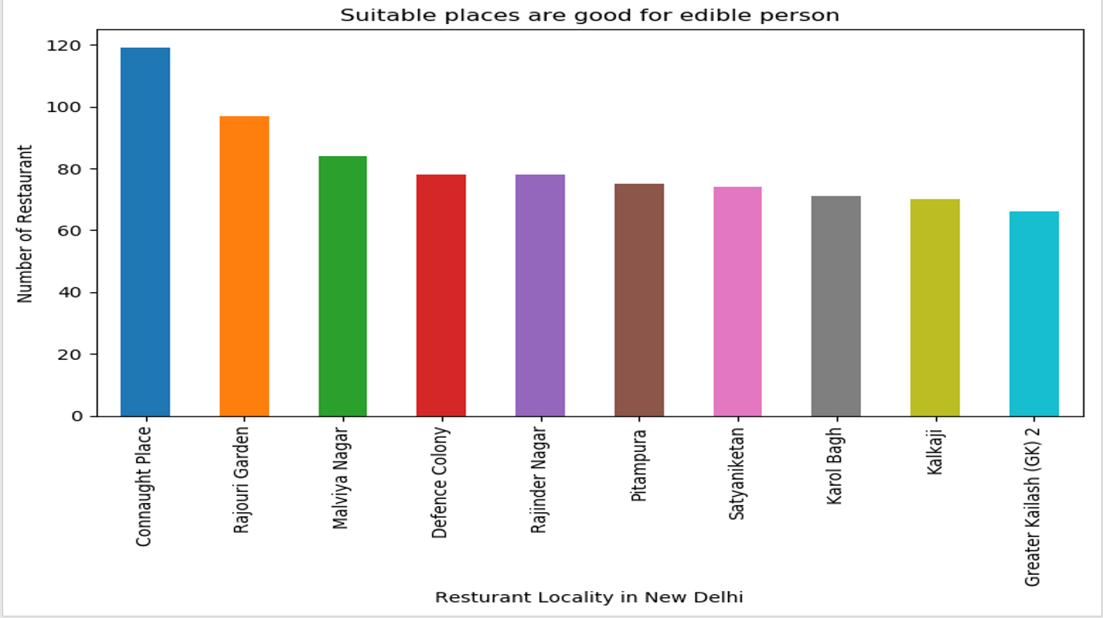

Slide 8
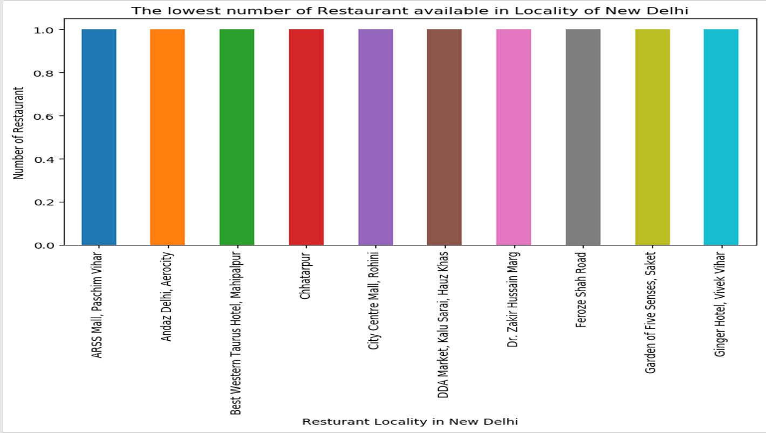

Slide 9
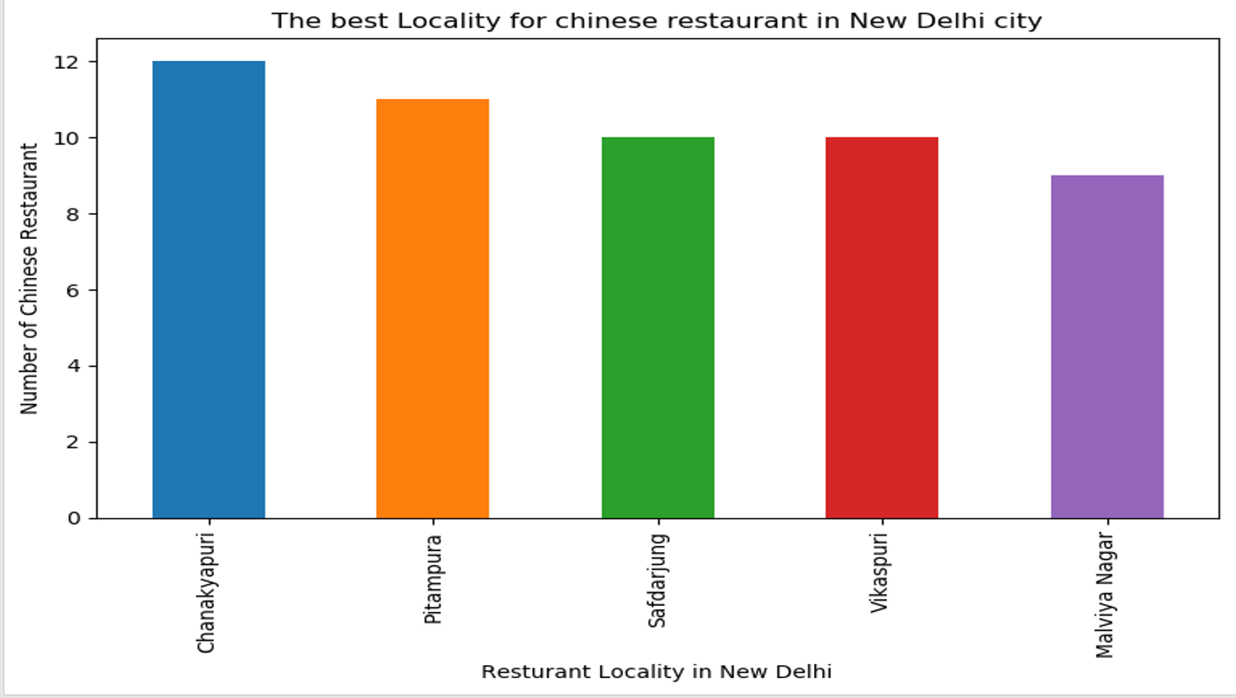

Slide 10
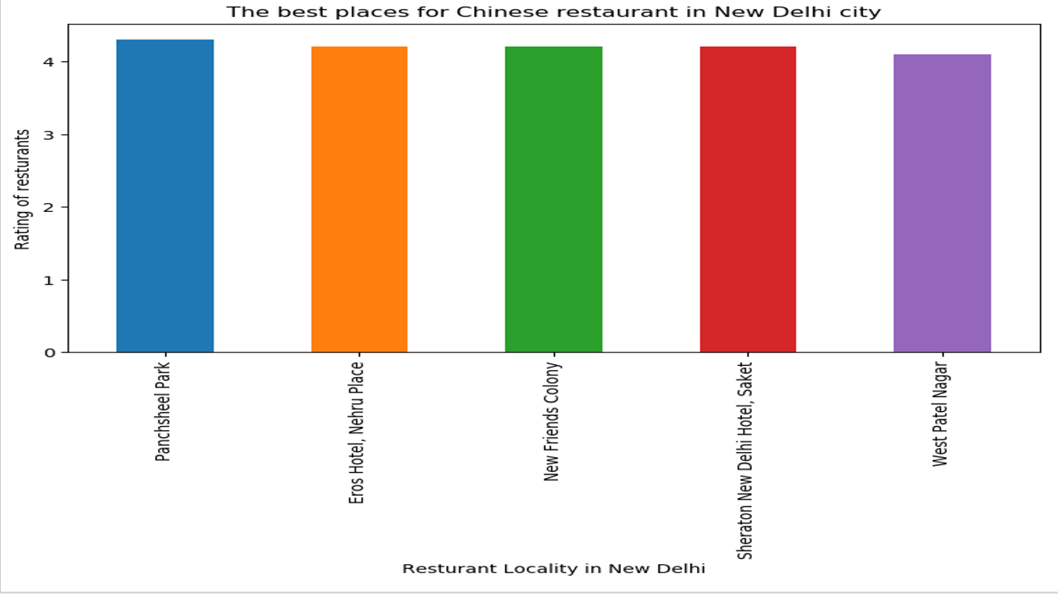

Slide 11
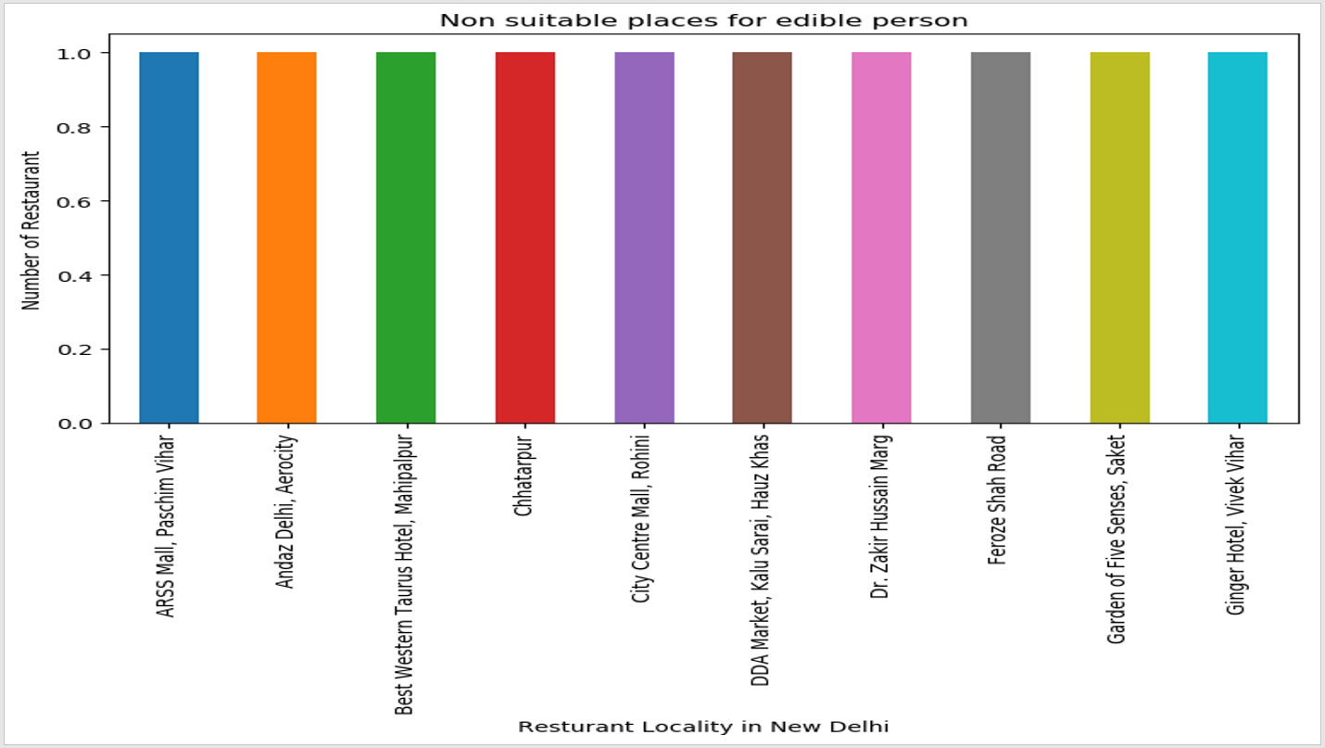

Slide 12
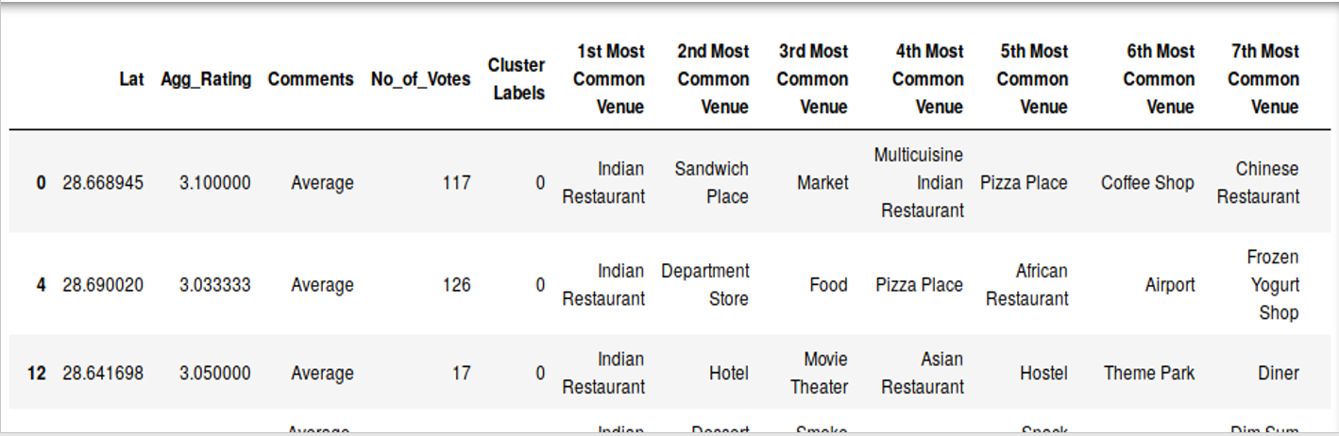
Cluster 1: The Indian restaurants are most recommended venues nearby the locations

Slide 13
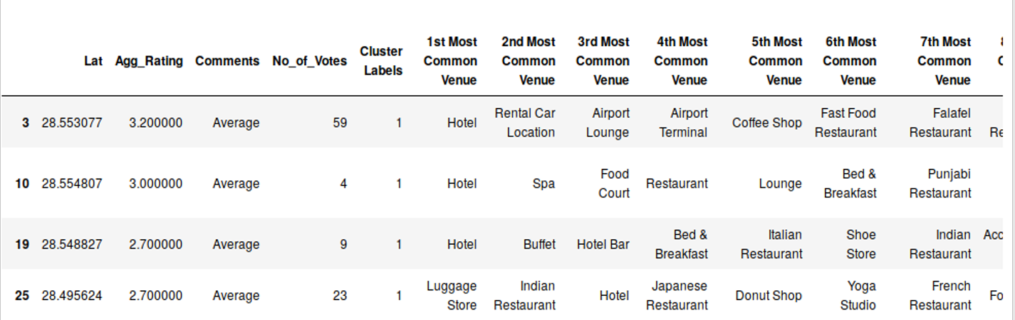
Cluster 2: It is recommended for the Hotel and Nightclubs venues areas

Slide 14
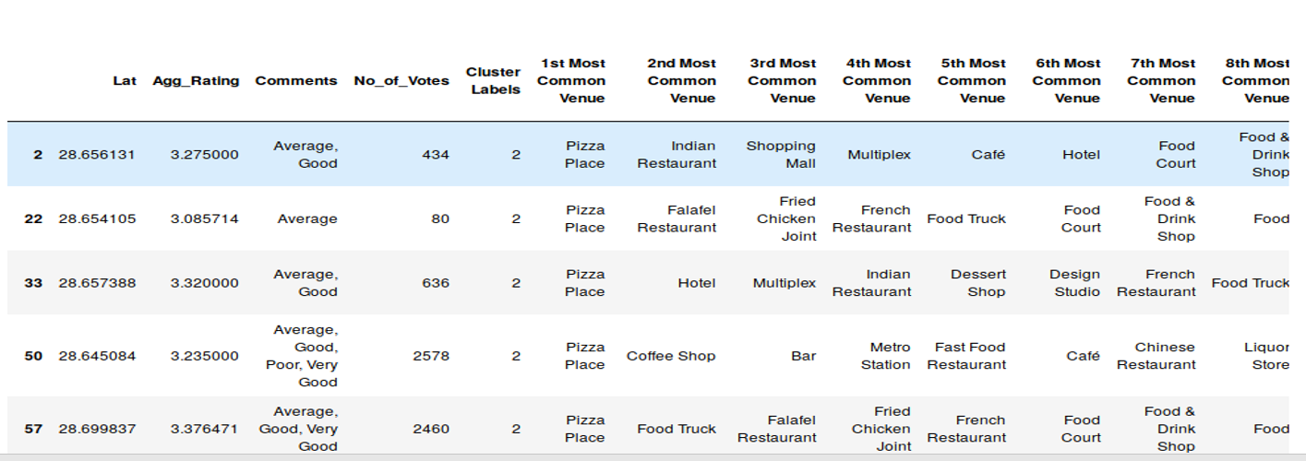
Cluster 3

Slide 15
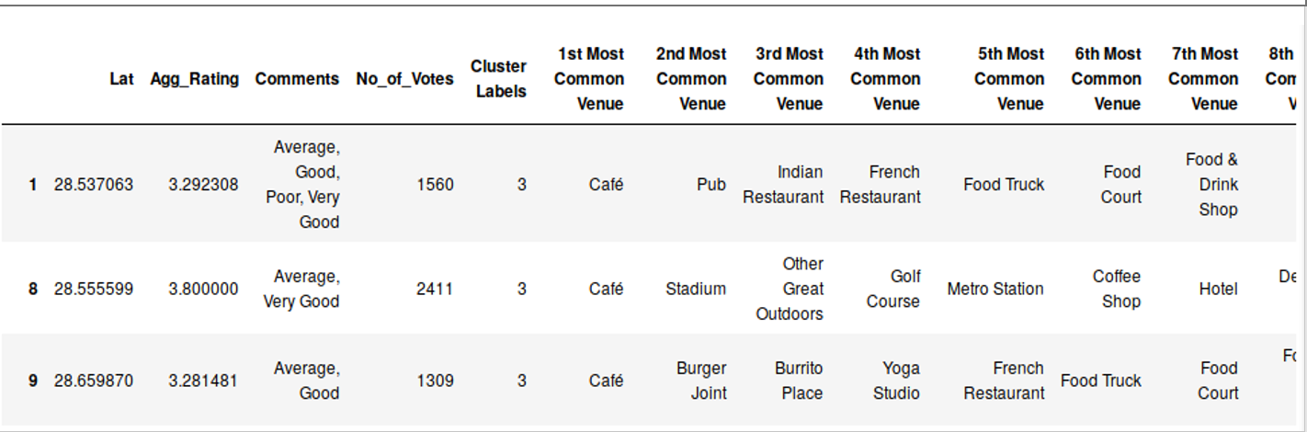
Cluster 4

Slide 16
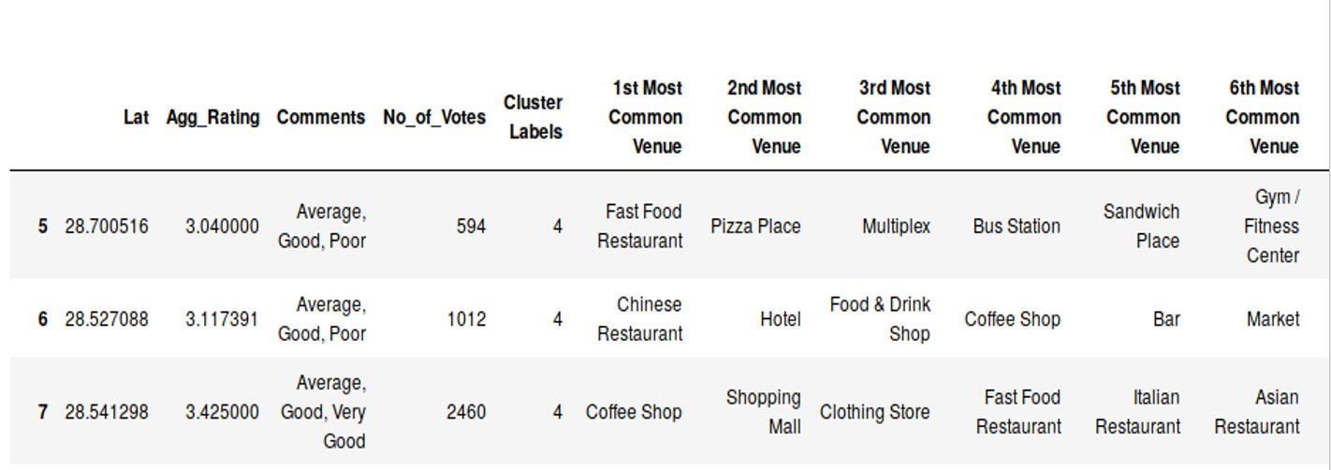
Cluster 5

Slide 17
Conclusion
Chanakyapuri, Pitampura, Safdarjung are some of the best neighborhoods for Chinese cuisine.
Panchsheel park, Nehru place have the best Chinese Restaurant.
Connaught place, Rajouri garden, Malviya nagar are the best places for edible person.
Greater kailash, Feroze shah road, Saket have best rated restaurants in New Delhi.

